Slide 1
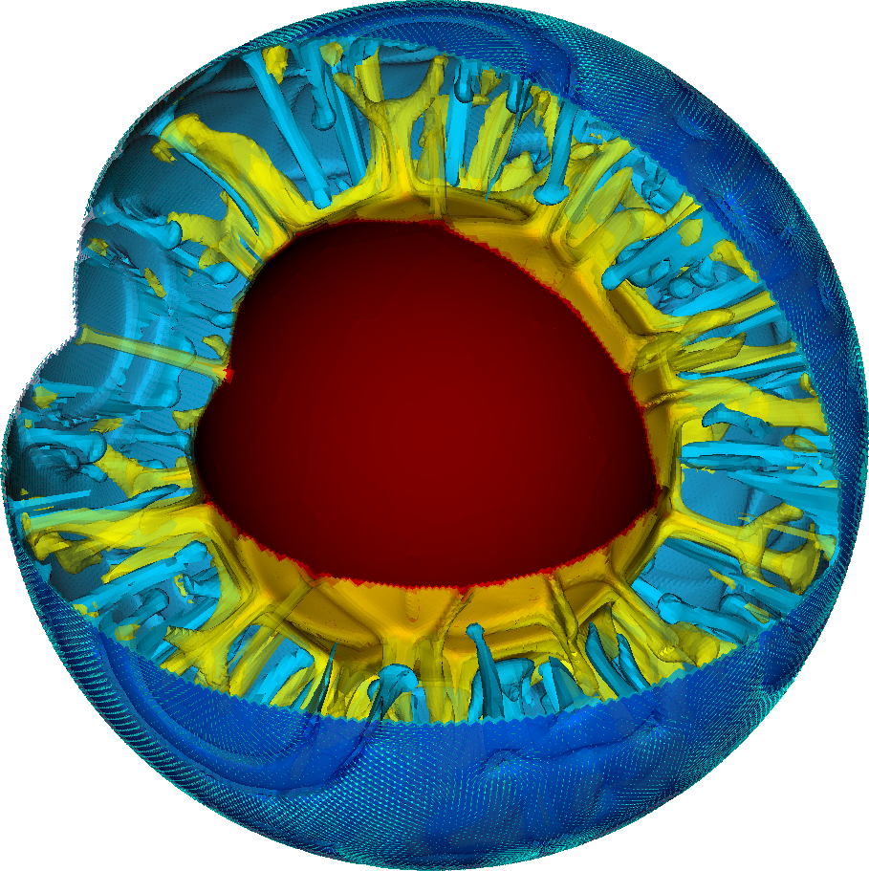

Computational Infrastructure for Geodynamics:
Software Repository Practices
Community
Lorraine J. Hwang, Interim Director
Scientific Software Registry Collaboration Workshop
13-14 November 2019
University of Maryland
geodynamics.org
CIG is funded by the NSF’s Geoinformatics program (in GEO-EAR) with contributions from NSF's Office of Advanced Cyberinfrastructure
Notes:
Thanks Alice for being the driving force behind this workshop.
Who we are and our software policies using our telecon discussions as a guideline

Slide 2

Who we are…
The Computational Infrastructure for Geodynamics (CIG) is a community-driven organization that advances Earth science by developing and disseminating software for geophysics and related fields.
• 85⁺ member institutions
• 900⁺ participants worldwide
• 20 countries
• 33 software packages
• Used worldwide
crust
mantle
core
Notes:
We aspire to accelerate the understanding of the dynamical properties of the Earth and Earth-like systems from core to crust, and beyond.
We do this by constructing computational models of the earth that are embodied in software.

Slide 3
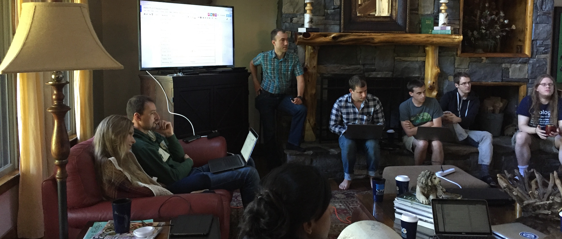
developers
researchers
Notes:
Because we support the development and dissemination of codes, we not only support a community of developers and researchers but also the user-developer
So our policies encompass both those who donate and develop codes and our user community as well

Slide 4

governance
elected
Executive Committee
HQ
Director
Science Steering
Committee
appointed
Working Groups
Computational Science
Dynamo
Education
Long Term Tectonics
Multiphysics
Mantle Convection
Seismology
Short-Term Crustal Dynamics
Ad Hoc
Icons made by Zlatko Najdenovski and Freepik from www.flaticon.com

Slide 5
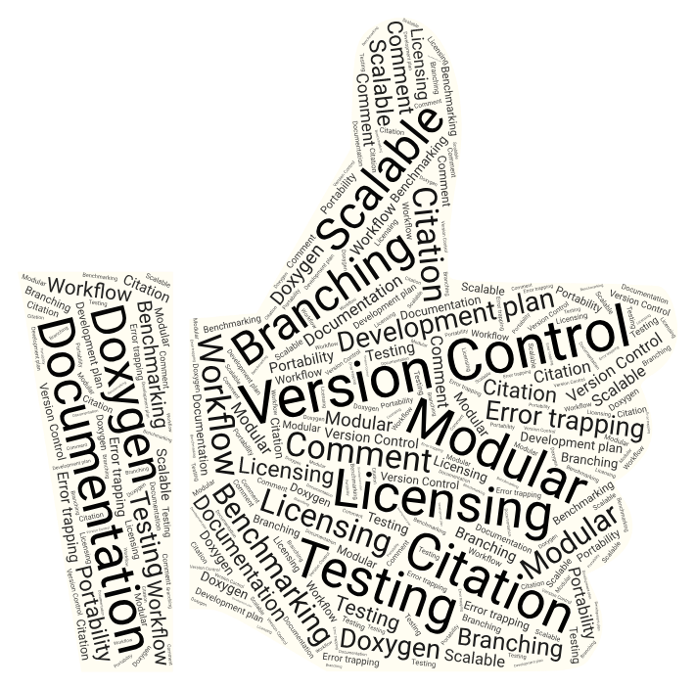
software donation
Code Donation Policy
Domain relevance
Follows Best Practices
version control, open source license,
published paper, documentation,
testing, build scripts, & CI
Approved by Governance
GitHub /geodynamics
Checklist under development
DOI Zenodo Zenodo community
Software page custom
https://geodynamics.org/cig/software/aspect/
Announcement to relevant list serves new releases too
webinars, workshops, etc.

Slide 6
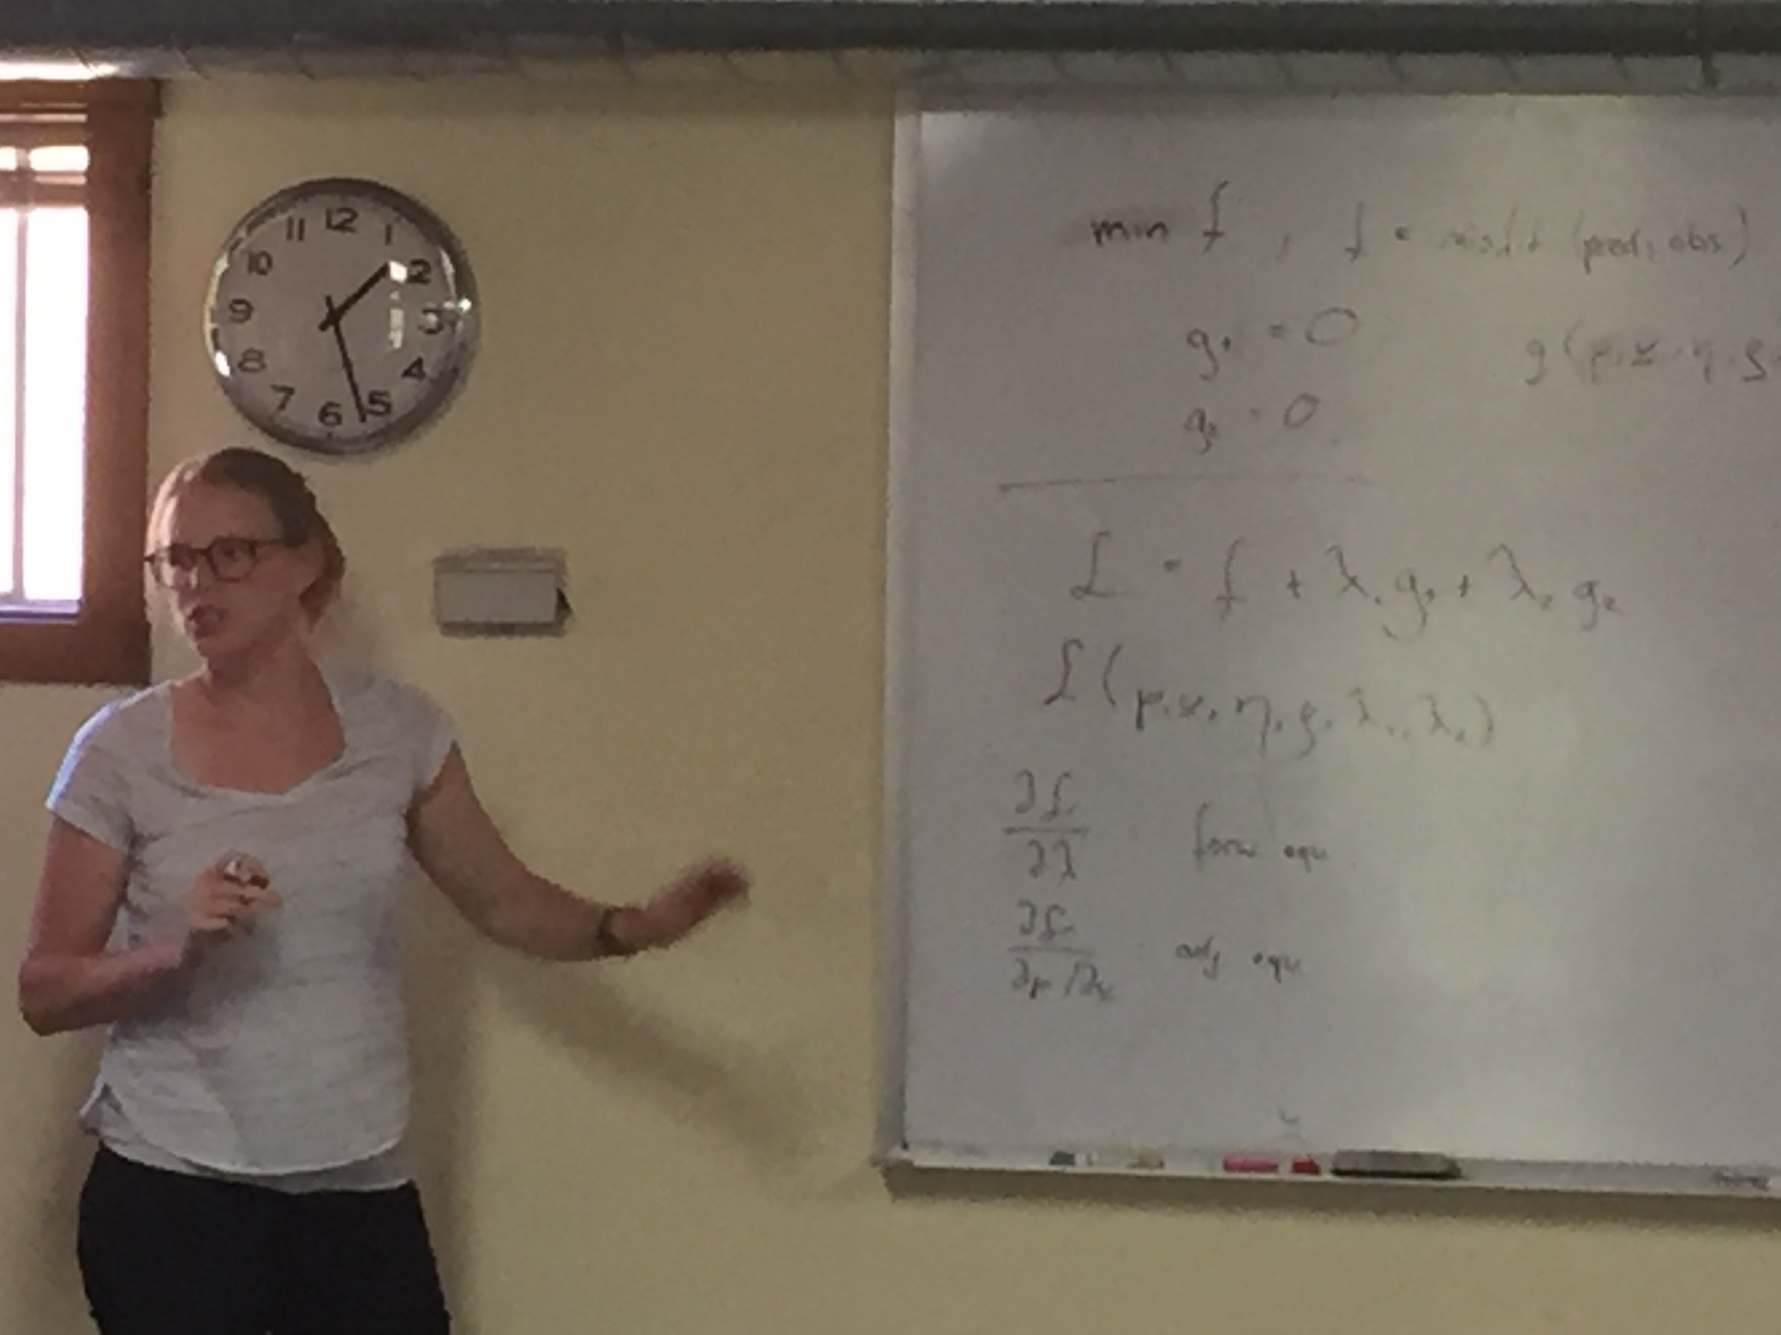
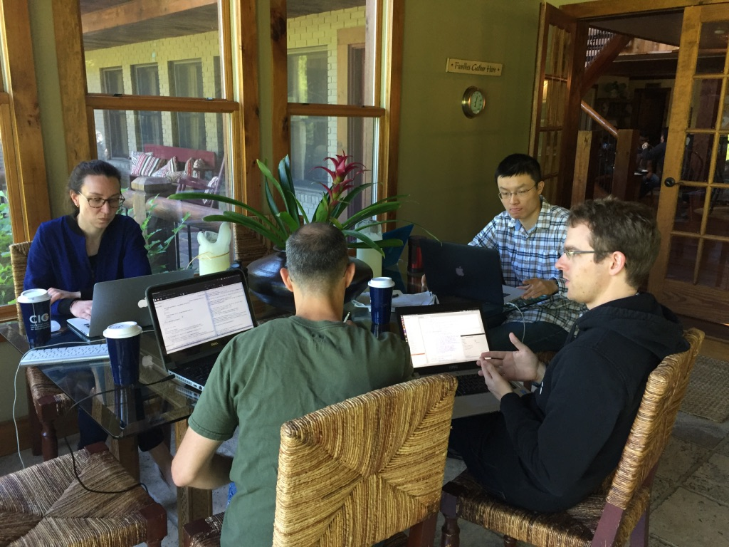
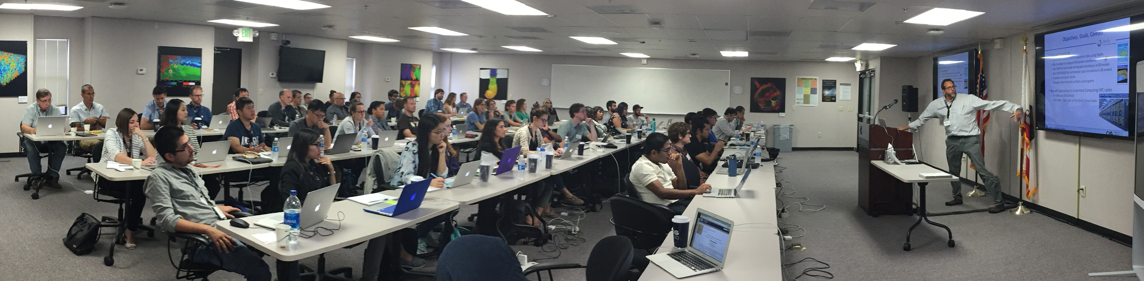
software users
Support
Defined support levels
Forums
Attributions
Acknowledgement to CIG
Cite the code
Code of conduct

Slide 7
Postdoctoral Researchers @CIG UC Davis
2 Postdoctoral Researchers – RSE software development and engineering
The positions are expected to contribute to the development and support of numerical modeling codes in geodynamics and towards conducting independent research.
Applications:
< 5 page project proposal
Letter of Collaboration
Deadline January 15, 2020
https://recruit.ucdavis.edu/JPF03269
For more information contact Lorraine Hwang:
ljhwang@ucdavis.edu
Notes:
We seek proposals for innovative, original, and feasible software engineering and/or software development projects that complement and/or improve our current practices.

